Slide 1
ENCRYPTION ALGORITHM

Slide 2
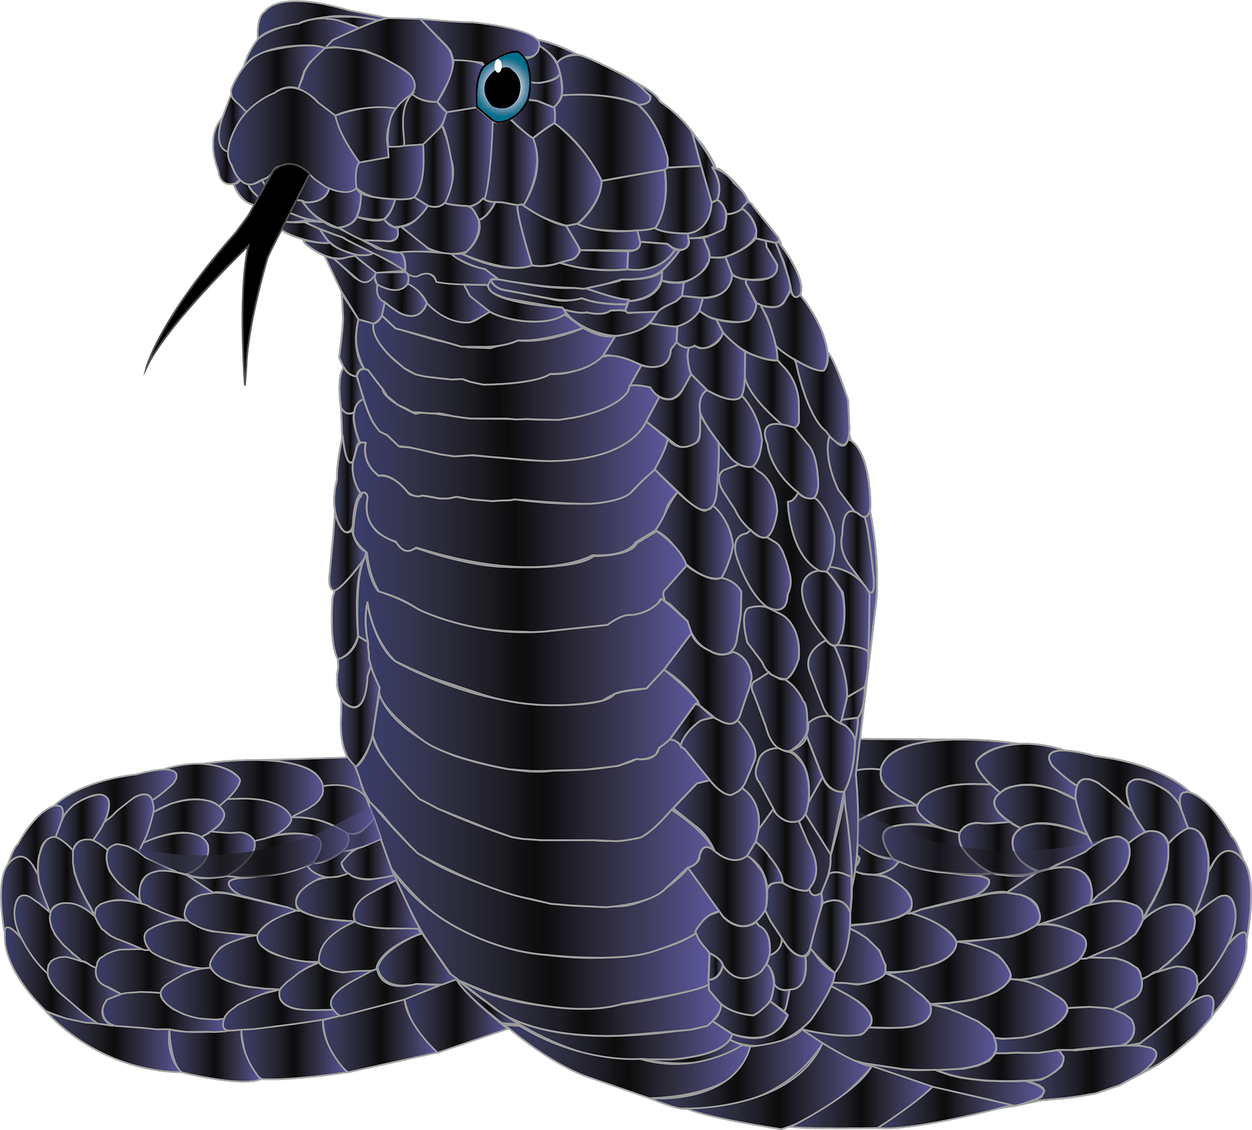
SERPENT
One of the most secure and efficient form of encryption algorithm

Slide 3
Serpent Cipher
1
What it is ?
2
How it works ?
3
How secure it is ?

Slide 4
What is Serpent Cipher
1
It is a data encryption algorithm

Slide 5
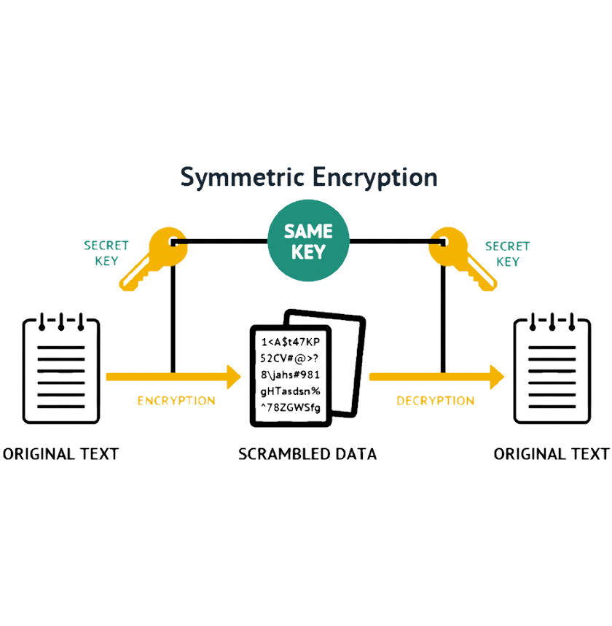
What is Serpent Cipher
It is a symmetric key block cipher
128-bit encryption/decryption
32 rounds of SPN
Symmetric encryption
Designed by Eli Biham, Ross Anderson and Lars Knudsen
SAME KEY
SECRET KEY
SECRET KEY
#()*#IDU*F#OIHD#%&%#$%$YG$%#@VBJI*^
ENCRYPTION
DECRYPTION
128-BIT PLAINTEXT
128-BIT CIPHERTEXT
128-BIT PLAINTEXT

Slide 6
How Serpent Cipher works
2

Slide 7
How Serpent Cipher works
Key schedule
+
Initial permutation
+
S-Boxes
+
Linear Transformation
+
Final permutation
=
Serpent cipher text

Slide 8
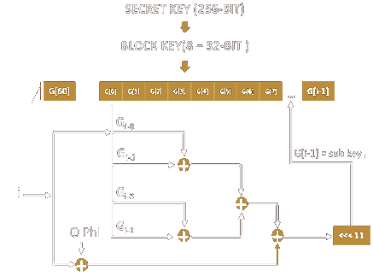
How Serpent Cipher works
Key schedule
256-bit Key to 33 128-bit Subkeys
Eight 32-bit words (G[0]-G[7])
G[0] G[1] G[2] G[3] G[4] G[5] G[6] G[7]
G[i-1]
ɸ, fractional part of golden ratio
i, round index
Rotate to left by 11

Slide 9
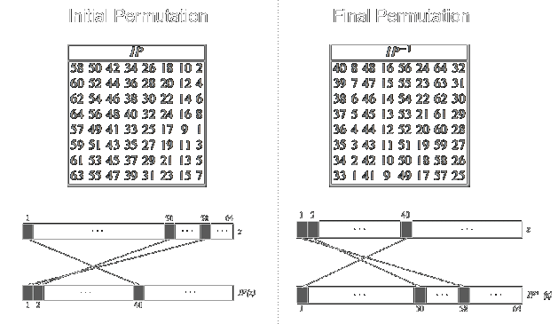
How Serpent Cipher works
Initial permutation (IP) & Final Permutation (FP)
Optimize implementation
Improve efficiency
IP before first round
FP after last round

Slide 10
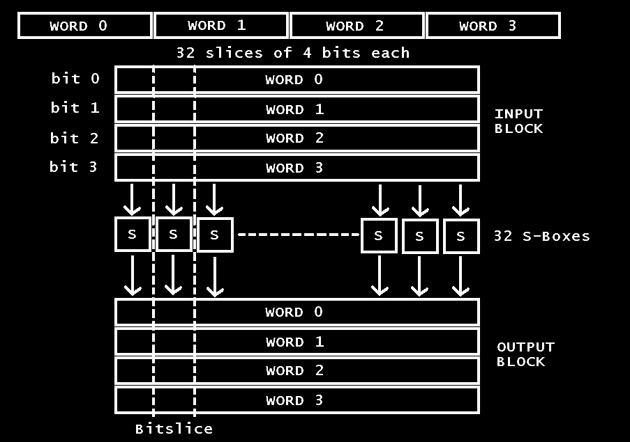
How Serpent Cipher works
S-Boxes
Based on DES S-boxes
4-bit permutations
Series of logical operations
Outputs 4 words of 32-bits

Slide 11
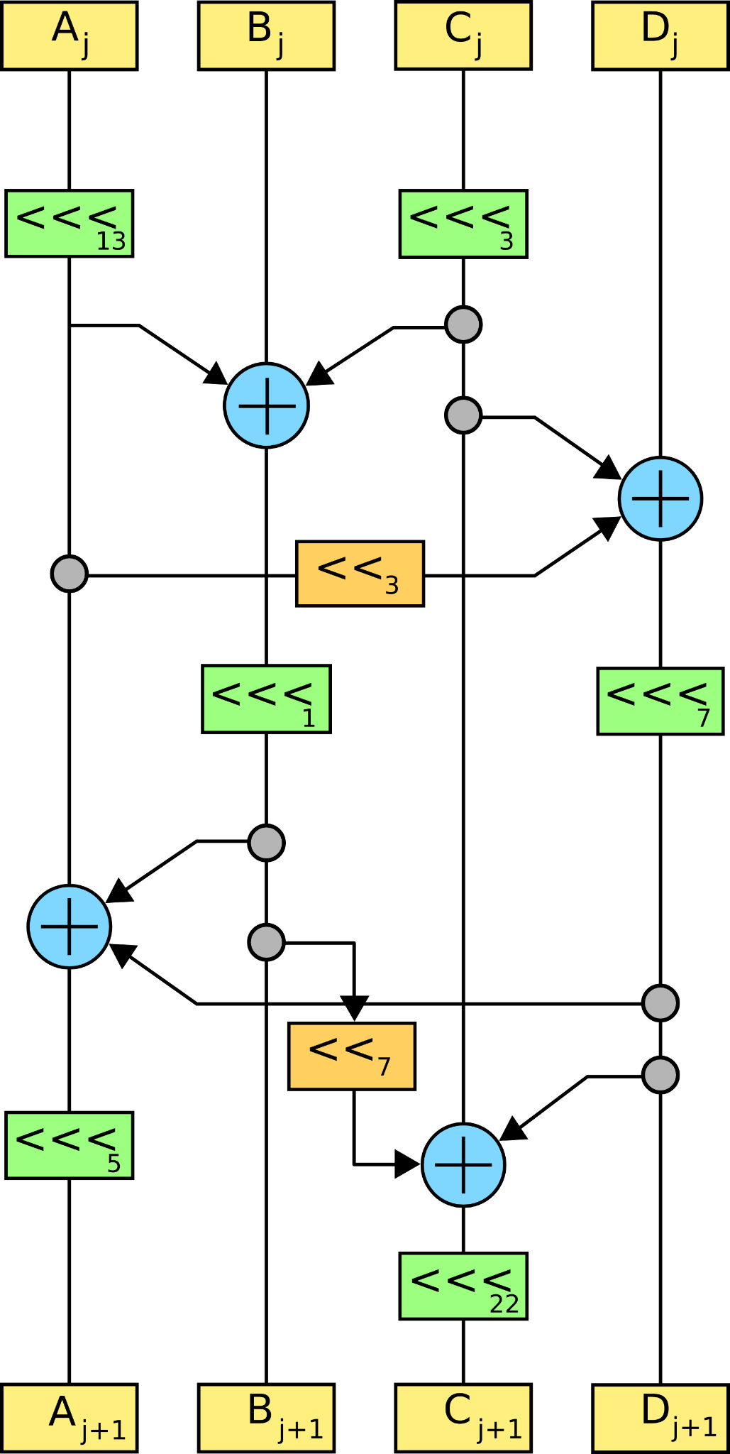
How Serpent Cipher works
Linear transformation
Maximize avalanche effect
XOR, bit shift left and bit rotate left
Linearly mixed
<<< denotes rotation and << denotes shift
Replaced in last round by additional key mixing

Slide 12
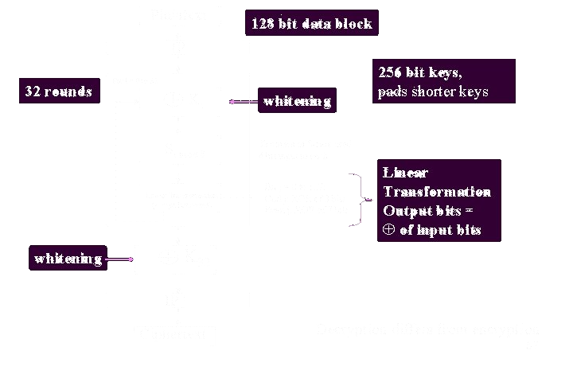
How Serpent Cipher works

Slide 13
How secure is Serpent Cipher
3
It is very secure!

Slide 14
Thank you!
Presented By:
Esraa Salah
Under supervision
Dr.Omar

